Slide 1
Price Scout
TEAM 4LOOP
Notes:
Patrick

Slide 2

Core Functionality
Searching for desired products
Comparing prices
Displaying trends of prices
Notes:
Patrick

Slide 3
Understanding Scope
Setup the following
Change cutting edge tech
API call frequency
Reducing store count
Login using Google
Page navigation
Login
Database
Notes:
Steven

Slide 4


Phase Two System Changes
Cutting Edge Tech
AI
Data Visuals
Notes:
Steven

Slide 5
Potential Improvements
Current
Enhancements
Login function redirects to a new tab.
We would like to make the login integral instead.

Slide 6
UI/UX Page Design
Responsive, user-friendly, minimalistic
How do users interact with the app?
Here are some early sketches compared to our MVP…
Notes:
Justin

Slide 7
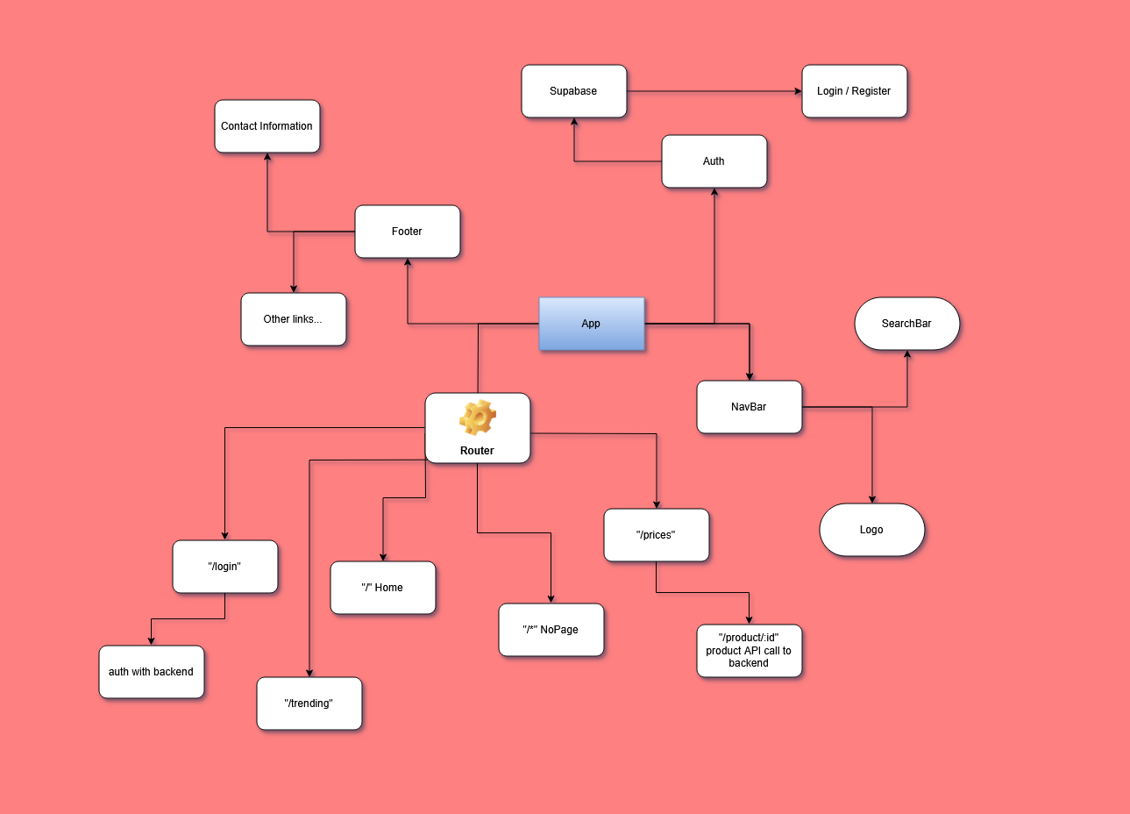

Slide 8
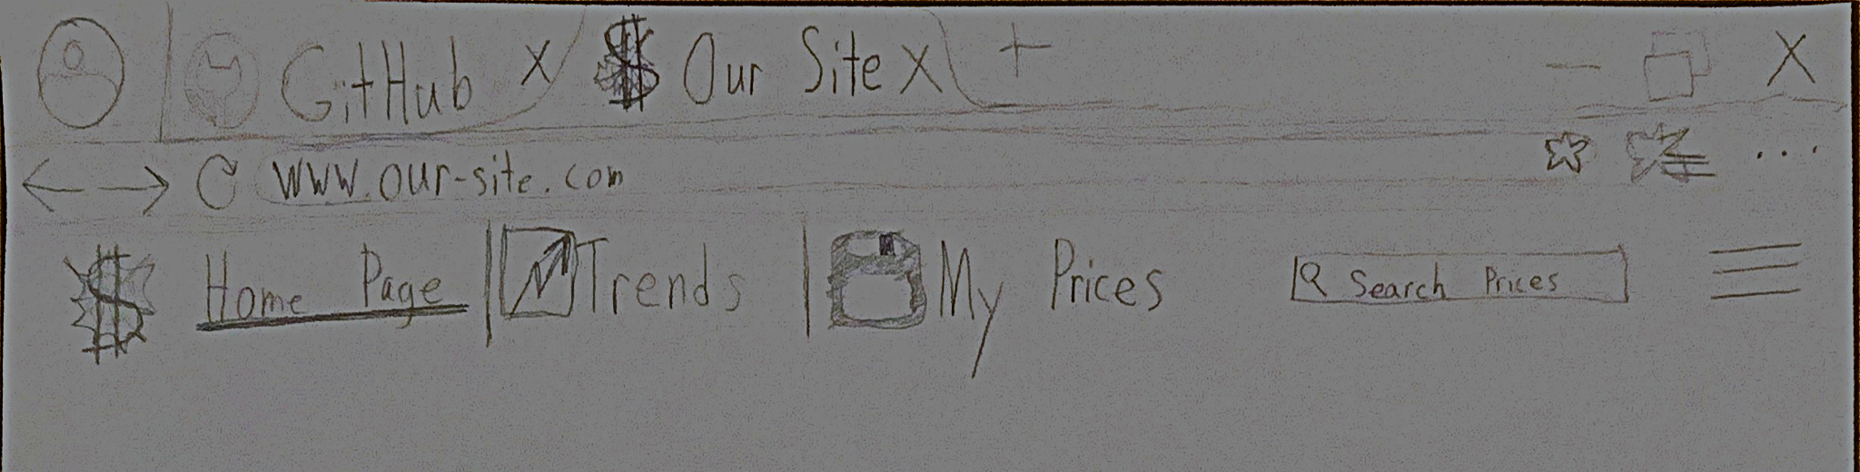
UI/UX progression
Ideation
Notes:
Justin

Slide 9
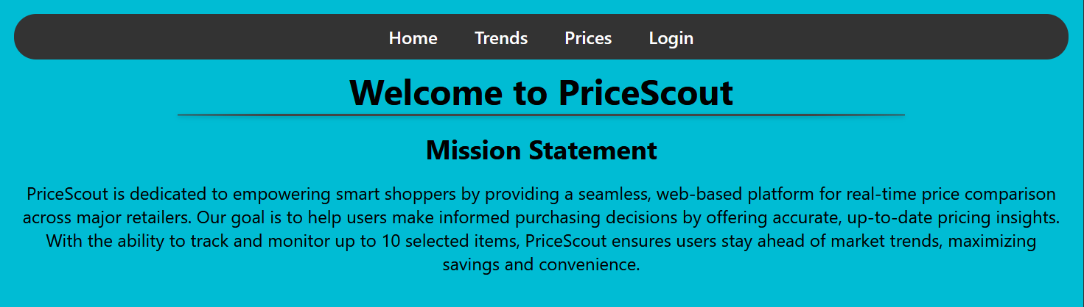
Prototype

Slide 10
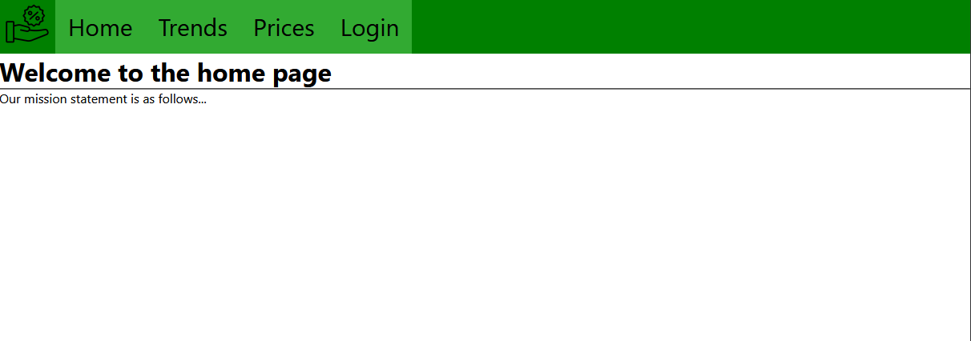
Earliest MVP

Slide 11
Data Flow Diagram Steps
User logs in
User searches for products
User interacts with products (e.g., adding to history)
External store sync
Notes:
Steven
1.1 Frontend (Google login) sends authentication data to Supabase Authentication
1.2 Supabase Authentication sends a response back to the Backend API (Django).
1.3 Backend API stores the login data in the Login Table.
2.1 Frontend sends a search query to the Backend API.
2.2 Backend API queries the Products Table and Store_Product_Data Table to fetch the relevant product data.
2.3 The results are sent back to the Frontend for display.
3.1 Backend API stores user-product interaction in the User_Product_History Table.
4.1 Backend API syncs with external stores and stores the API response in the Store_API_Logs and Store_API_Responses Tables.
4.2 The Store_Syncs Table keeps track of when syncs occur.

Slide 12
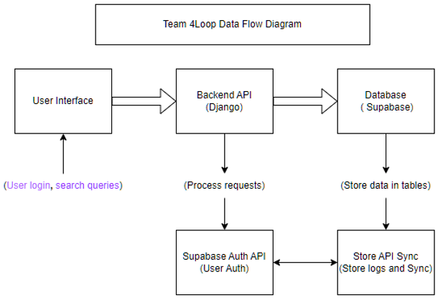
Data Flow Diagram
Notes:
Steven

Slide 13
Thank You
Price-Scout
Notes:
Patrick

